Slide 1
AI Driven Hyper Personalization
Team: Tensor Titans

Slide 2
Problem Statement
Modern customers expect highly personalized experiences that cater to their unique preferences. In this hackathon, participants will develop a Generative AI-driven solution that enhances hyper-personalization by analyzing customer profiles, social media activity, purchase history, sentiment data, and demographic details. The challenge is to design a system that generates personalized recommendations for products, services, or content while also providing actionable insights for businesses to optimize customer engagement.

Slide 3
Solution Overview
Our solution focuses on:
Predicting customer metrics (churn rate, profits generated for bank, financial acumen, risk appetite)
Recommending customers relevant financial products.
Using GenAI powered sentiment analysis to refine those recommendations.
Providing actionable insights for banks to optimize engagement and boost revenue.

Slide 4
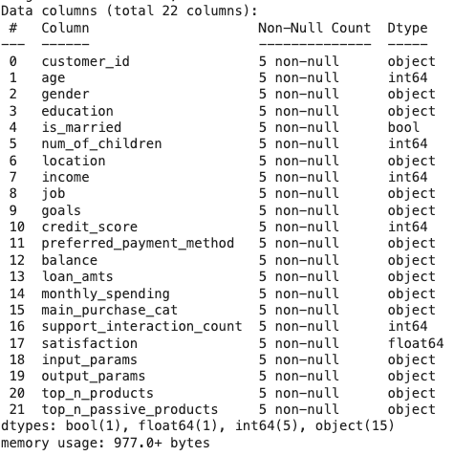
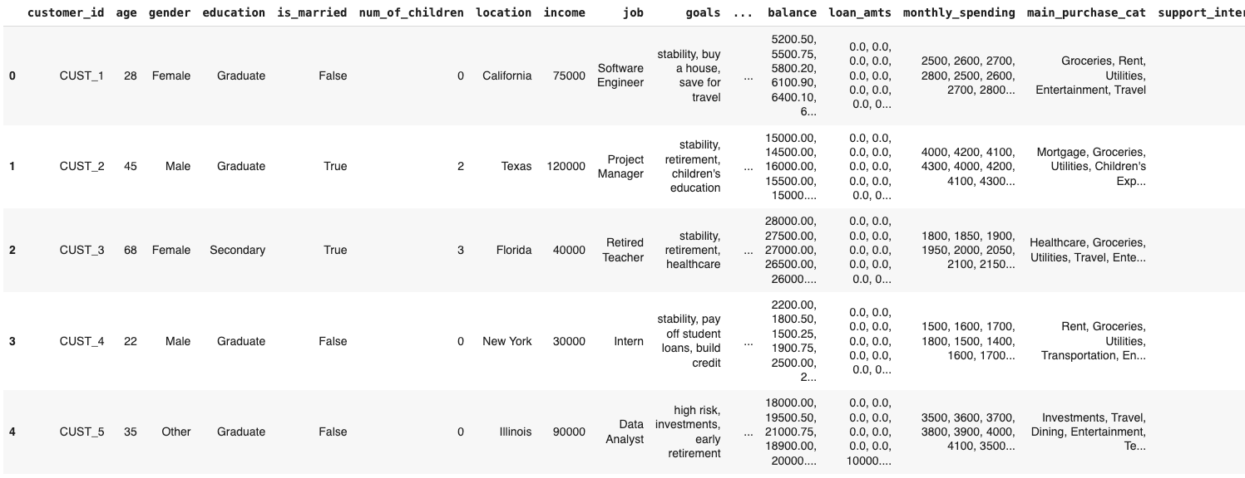
Dataset - Customer Info

Slide 5
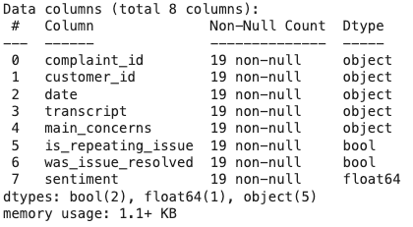
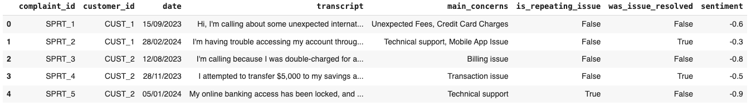
Dataset - Customer Support Record

Slide 6
Technical Approach
Google Gemini 2.0 Pro LLM used for sentiment analysis and personalized recommendation generation from various data sources
Distance metrics like Mahalanobis, Manhattan and weighted distance used to rank products based on 4 customer parameters (churn rate, profit potential, risk appetite, financial acumen)
First LLM call generates the 4 parameters, followed by weighted distance to get a subset of products
Second LLM call ranks the subset of products based on the context like sentiment, topics of interest, etc

Slide 7
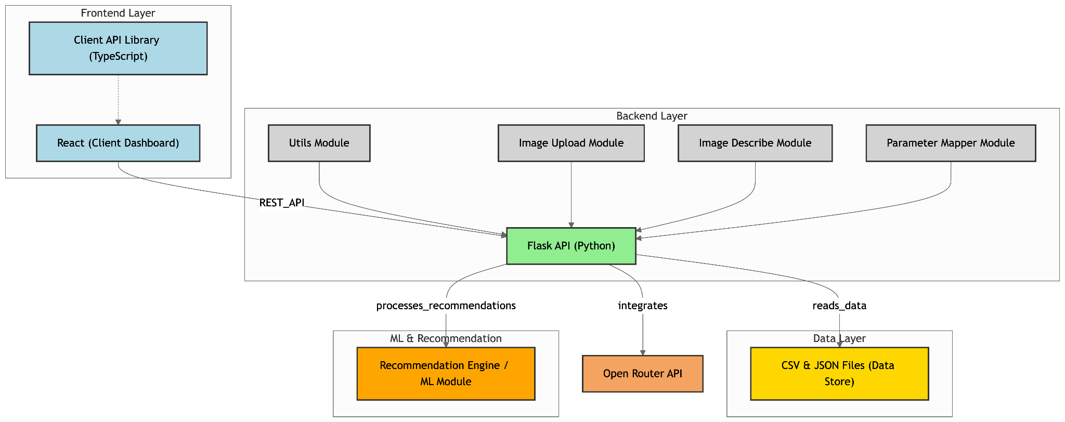
Technical Approach - Architecture

Slide 8
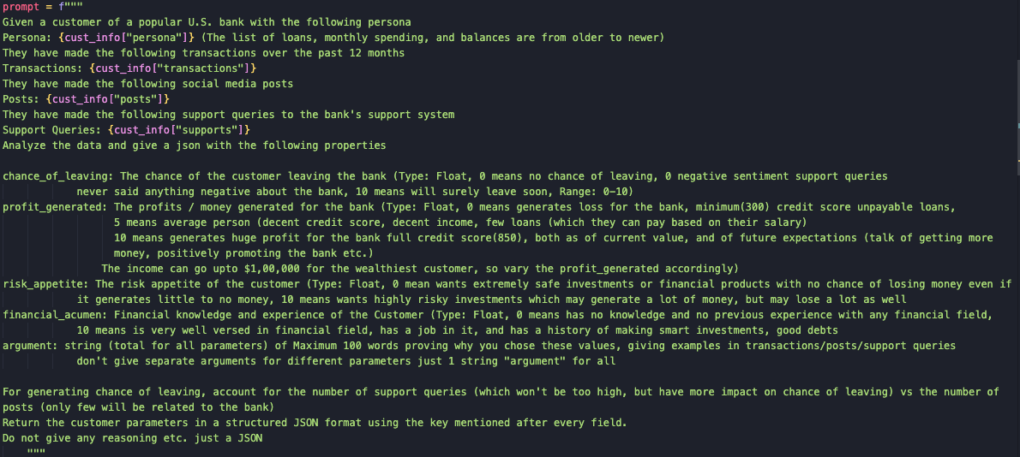
Technical Approach - Prompt to generate customer params

Slide 9
Impact & Use cases
Enhanced customer retention: Identifies at-risk customers using churn probability metrics and offers tailored incentives (e.g., discounted rates), reducing attrition and boosting loyalty.
Increased revenue potential: Matches high-profit products (e.g., long-term investments) to financially capable customers, driving product adoption and maximizing bank profitability.
Improved customer experience: Delivers hyper-personalized recommendations (e.g., premium travel credit cards for frequent travelers) based on sentiment and preferences, enhancing satisfaction and trust.

Slide 10
Conclusion
Effective Hyper-Personalization: Successfully delivers tailored financial recommendations using multi-dimensional customer profiling (churn rate, risk appetite, financial potential).
Advanced AI-Driven Solution: Combines LLM-powered sentiment analysis and distance-based models (Mahalanobis, weighted vector) for precise, context-aware product matching.
Dynamic & Scalable System: Real-time sentiment refinement and Flask-based architecture ensure adaptability and efficient recommendation delivery for banks.
Business Value Delivered: Boosts customer retention, revenue growth, and satisfaction by aligning products with customer needs and bank goals.
Future-Ready Framework: Sets the stage for expansion with multi-modal inputs (voice, video) and reinforcement learning for continuous improvement.

Slide 11
THANK YOU

